Slide 1
Team Agile Robotic Controls
Logan Beaver
Justin Campbell
Tyler Paddock
Ronald Shipman

Slide 2
Project Overview
Develop initial robotics platform
Public Outreach
Increase interest in STEM fields
Engineering deficit
Educational robotics platform
Fluid Power
Control Systems

Slide 3
Major Design Decisions
Quadruped Locomotion
Agile motion
Stable
Rugged Terrain
Pneumatic Power
High energy density
Clean and lightweight

Slide 4
Mechanical Design

Slide 5
Pneumatic Design

Slide 6
Power Source Options
 | Advantages | Disadvantages
Hydraulic Power Source | -Highest achievable power density | -High maintenance -Heavy -Dirty
Electric Power Source | -Accurate positioning | -Lowest achievable power density -Noncompliant
Pneumatic Power Source | -Higher power density than electric power -Low Maintenance -Compliant action from fluid compression | -Compressible fluid causes inaccuracy in positioning

Slide 7
Components
Pneumatic components include:
Air Supply Tank
Air Compressor
Double Acting Air Cylinders (w/ feedback)
Receiver Tank
Solenoid Valve
Directional Control Valves (4/2)
Pressure Relief Valve
Tubing

Slide 8
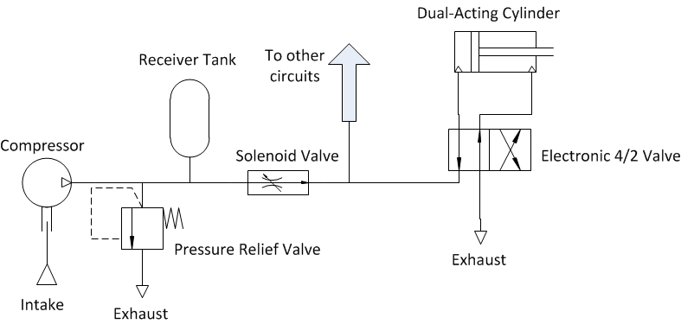
Pneumatic Circuit

Slide 9
What’s Next?
Determine necessary output forces of cylinders based on kinematic equations
Select appropriate pneumatic components based on needed specifications
Test air cylinders
Pneumatic circuit construction
Test circuit with control system

Slide 10
Simulation and Verification

Slide 11
Kinematic Modelling
Homogenous Transformations
Determines cylinder stroke

Slide 12
Dynamic Model
Lagrangian Mechanics
Non-inertial reference frames
Arbitrary grounded reference frame
Determines mechanical properties of components
27 Equations

Slide 13
Control architecture and electronics

Slide 14
Questions?

